Slide 1
Gravity and Orbits
By: Steven, Obaidah, Fang, and Angela

Slide 2
Table of Contents
Wireframe and Mockups
Sample Input/Output
Class Diagram
Task Breakdown, Timeline, and Task Assignment
Sprint Report

Slide 3
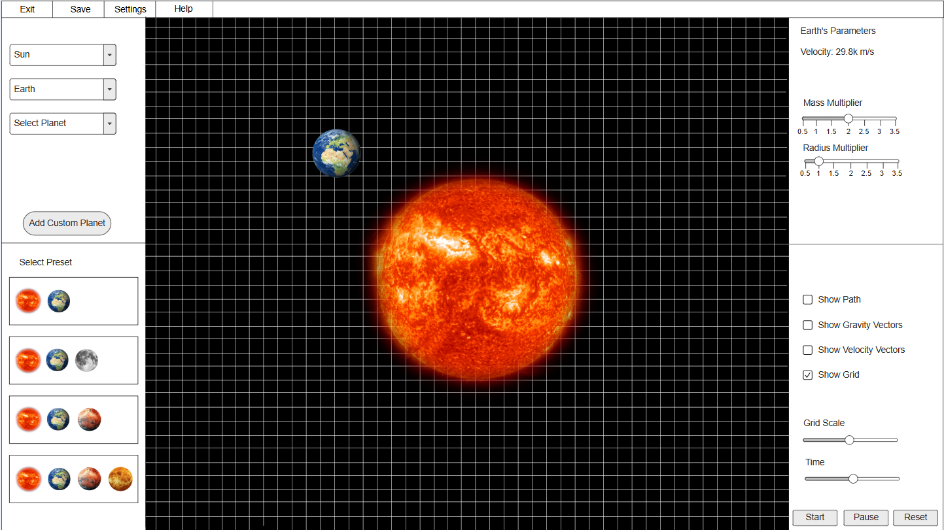


Wireframe and Mockup 1

Slide 4
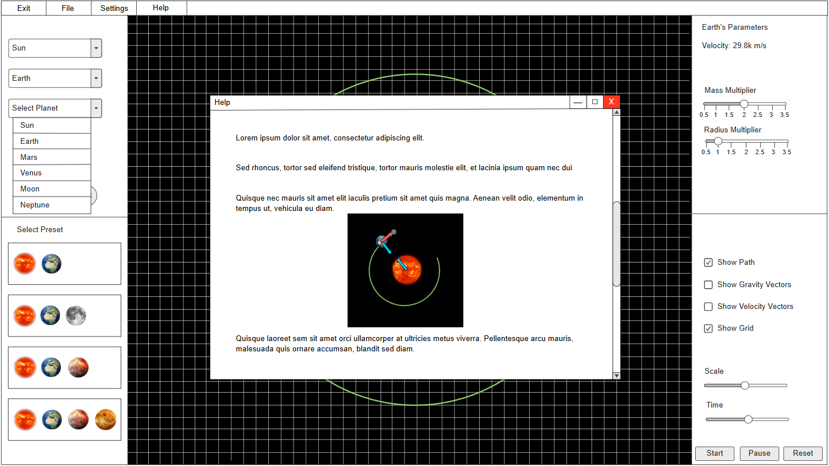
Wireframe and Mockup 2

Slide 5
Sample Input/Output
Input | Output
Select a planet | Selected planet will appear in space and its parameters will be displayed on the right side of the screen
Click on “Help” button | Pop-up appears that explains to the user how to use the application
Select a preset | Displays all the elements of the selected preset, such as the planets associated with it and the default scale.
Check box “Show Grid” | Shows a grid in the background (in space) to allow the user for comparing the planets’ sizes.
Increase “Mass Multiplier” slider | Increases the value of the mass of the selected planet by the chosen multiple, which affects its gravitational force on other planets.

Slide 6
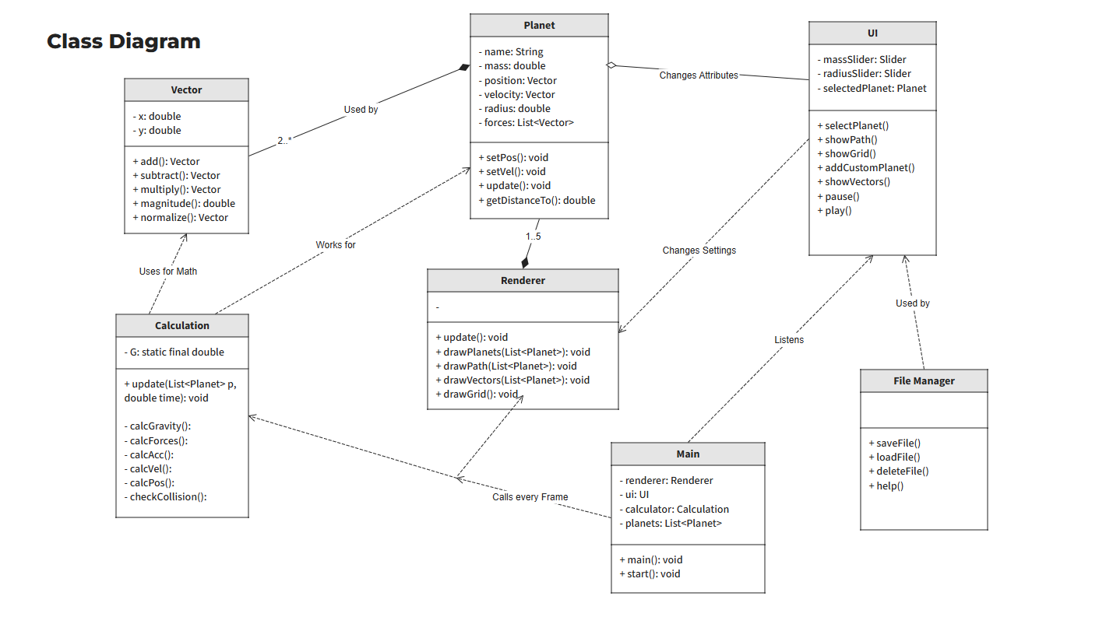
Class Diagram

Slide 7
Tasks Breakdown
Teammate | Tasks
Steven | Implement planet creation method Implement planet orbit method Implement collision animation
Obaidah | Create basic user interface Create file manager class Set up the main class
Fang | Implement planet animation Implement physics calculations Implement rendering
Angela | Refine UI using CSS Create help interface Manage planet data flow

Slide 8
Timeline
Teammate | Week 1-2 | Week 3-4 | Week 5-6
Steven | Implement planet creation method | Implement planet orbit method | Implement collision animation
Obaidah | Set up the main class | Create basic user interface | Create file manager class
Fang | Implement planet animation | Implement physics calculations | Implement rendering
Angela | Create help interface | Manage planet dataflow | Refine UI using CSS

Slide 9
Steven's Sprint
Received Stories | Resolved Stories | Carry Over Stories | Blocked Stories
As a user, I want to add planets that aren’t included in the presets so I can see how the gravitational force changes.
As a user, I want to select a planet so I can see its parameters.
As a user, I want to see the velocity of the planet selected so I can see the change in the velocity when changing some of the parameters.

Slide 10
Obaidah's Sprint
Received Stories | Resolved Stories | Carry Over Stories | Blocked Stories
As a user, I want to save the file and be able to load it back so I can access it later on without redoing everything.
As a user, I want to be able to delete created files so I can save storage space when I don’t need it anymore.
As a user, I want different presets with different amounts of planets so I can easily access the animation.

Slide 11
Fang's Sprint
Received Stories | Resolved Stories | Carry Over Stories | Blocked Stories
As a user, I want to see the vectors of force and path so I can know what’s happening between the planets.
As a user, I want to change the mass or the radius of the planet so I can see the effect of the gravitational force on other planets.
As a user, I want to reset the animation so I can choose different combinations of planets with ease.

Slide 12
Angela's Sprint
Received Stories | Resolved Stories | Carry Over Stories | Blocked Stories
As a user, I want to have a help menu so I can have support when I encounter difficulties.
As a user, I want to play and pause the animation so I can have better control of the animation.
As a user, I want an option to have a grid so I can compare the planets’ sizes.
As a user, I want to decide the scale of the animation so I can see it from small to big.

Slide 13
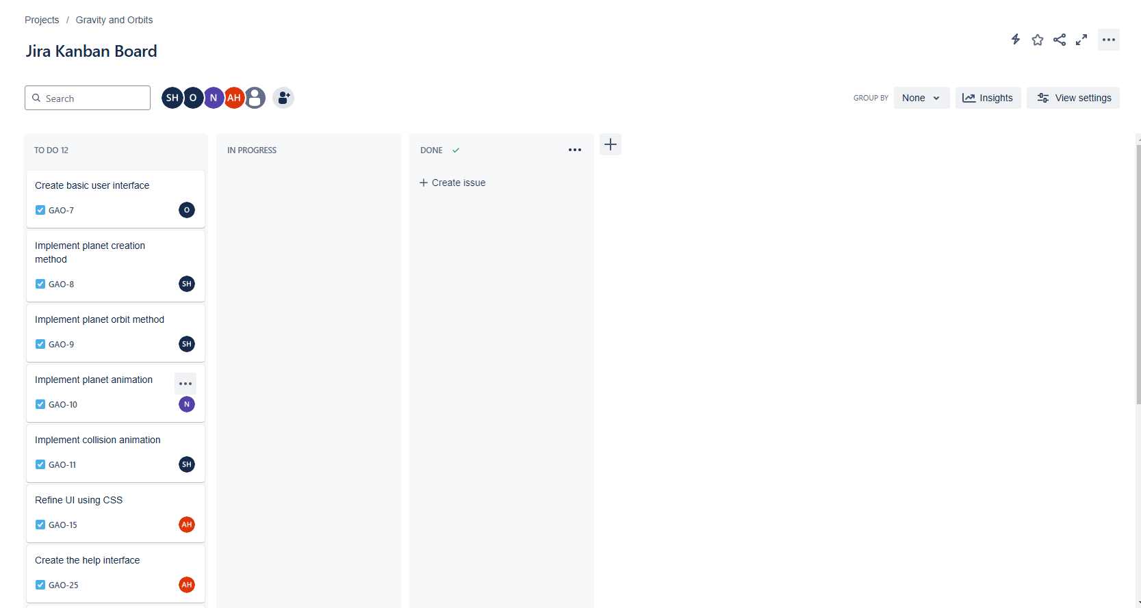
Jira Kanban Board

Slide 14
Thank you

